Slide 1
Web Servers &
▶ Apache HTTP
App Servers
▶ Nginx
▶ Apache Tomcat
Practical implementation of Apache, Nginx,
Apache Tomcat & HAProxy on AWS EC2
▶ HAProxy
Prepared By – Divya Erupaka

Slide 2
Agenda
Tasks covered in this presentation
Apache HTTP Server
Tomcat Service File
01
04
Install & run on port 81 · Deploy index.html
Create systemd .service file for Tomcat
Nginx Web Server
HA Proxy
02
05
Install & run on port 82 · Deploy index.html
Install, configure & test load balancing
Apache Tomcat
Summary
03
06
Install on port 8082 · Deploy sample app
Architecture overview & key takeaways

Slide 3
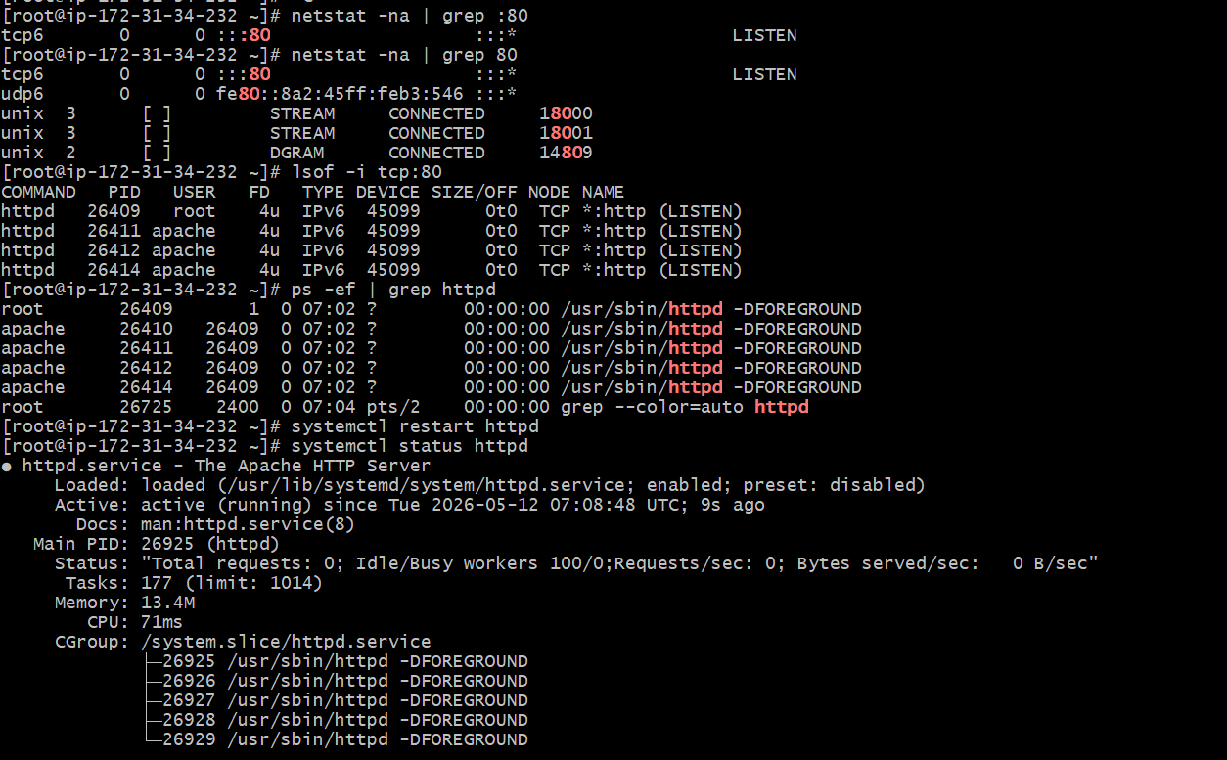
Task 1 – Apache HTTP Server (Port 81)
Install Apache and customize port from 80 → 81
Install Apache
yum install httpd -y installs the Apache HTTP server package on Amazon Linux 2023.
Change Default Port
Edit /etc/httpd/conf/httpd.conf — change Listen 80 to Listen 81 to serve on custom port.
systemctl status httpd — Apache active on port 81

Slide 4
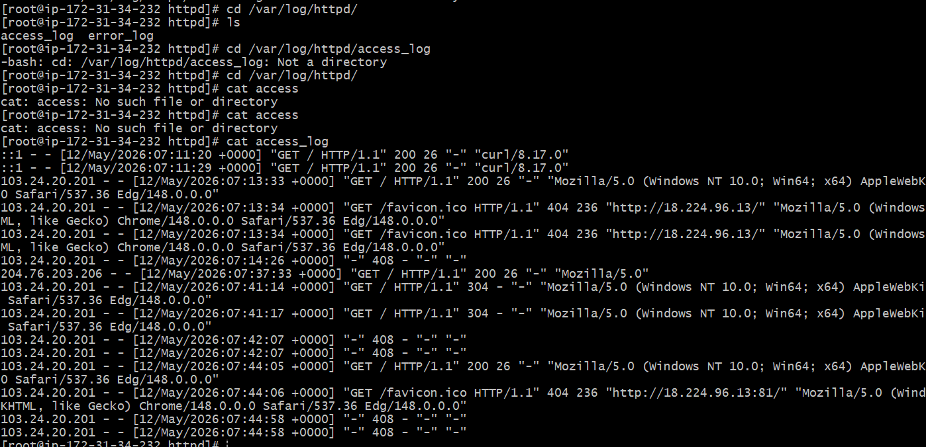
Task 2 – Deploy index.html on Apache
Serve a custom web page from /var/www/html/
Create index.html
Place a custom HTML file at /var/www/html/index.html — Apache's default document root for serving static content.
Verify via Browser
Access http://<public-ip>:81 in a browser. Apache access logs at /var/log/httpd/access_log confirm HTTP 200 requests.
Apache access_log confirming GET / HTTP 200 responses

Slide 5
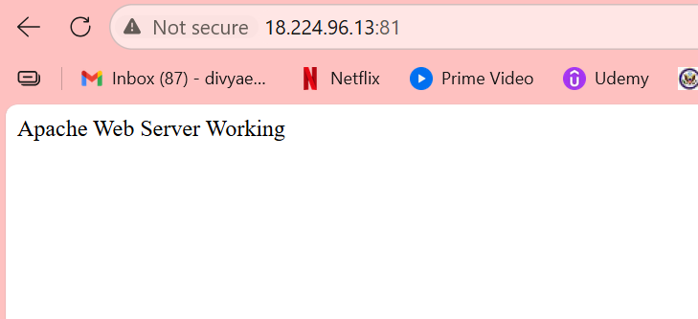
HTTPD – Deploy index.html
changed the httpd port to 81 in /etc/httpd/conf/httpd.conf Default log file location for Apache HTTPD is /var/log/httpd/access_log

Slide 6
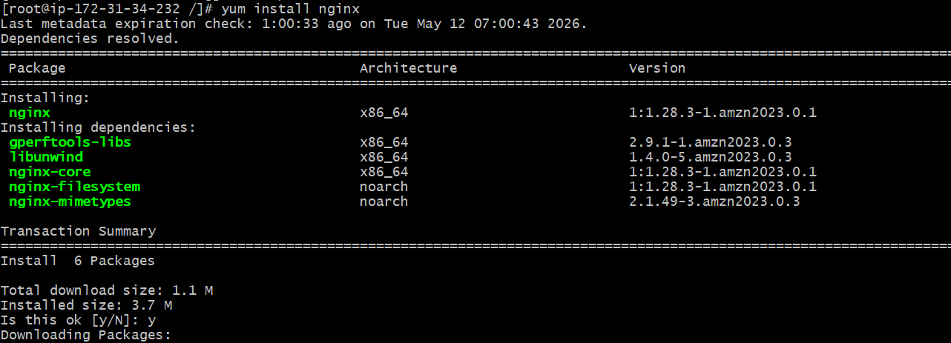
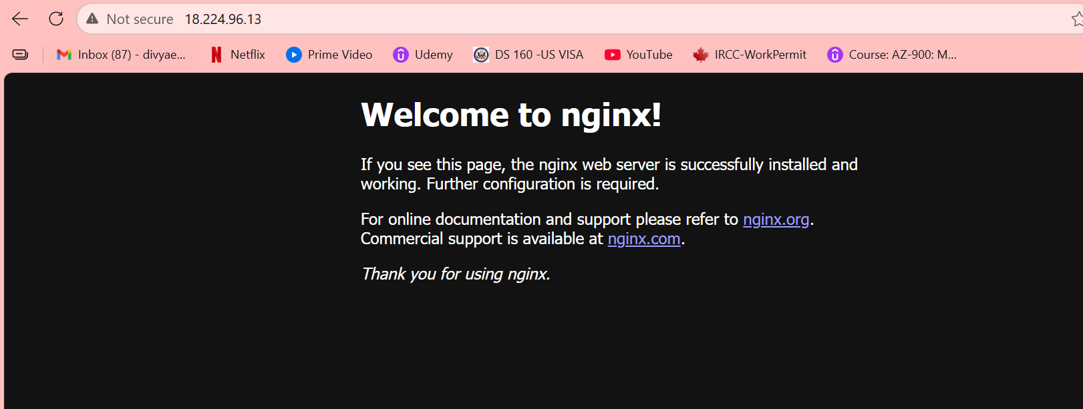
Tasks 3 & 4 – Nginx Web Server (Port 82)
Install Nginx, configure port 82, deploy index.html
Install & Configure Nginx
yum install nginx -y installs Nginx. Edit /etc/nginx/nginx.conf to change listen 80 → listen 82. Open port 82 in AWS Security Group inbound rules.
Deploy & Verify
Place index.html in /usr/share/nginx/html/ (default root). Restart nginx with systemctl restart nginx. Browse to http://<ip>:82 to confirm the page is served.

Slide 7
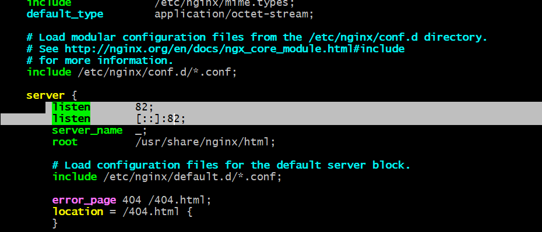
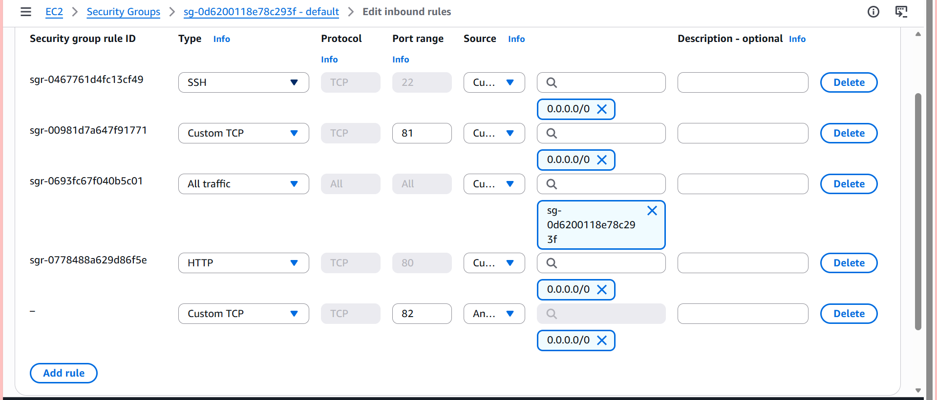

Tasks 3 & 4 – Nginx Web Server (Port 82)
Install Nginx, configure port 82, deploy index.html

Slide 8
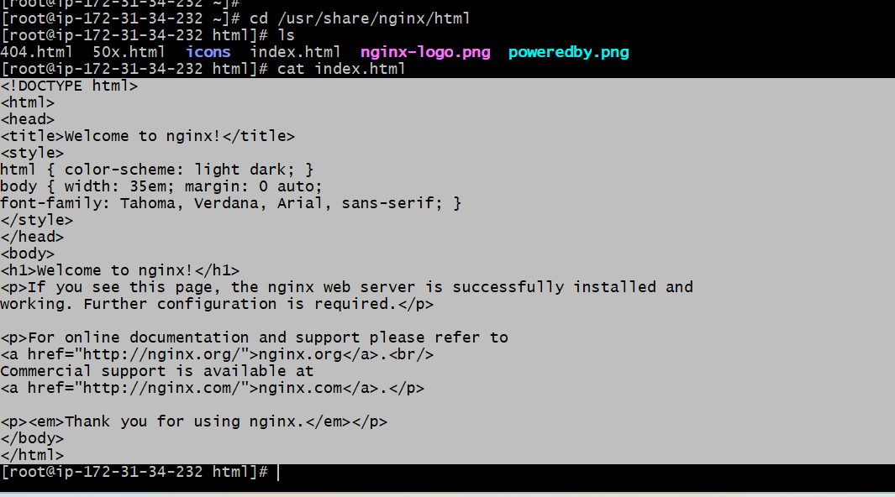

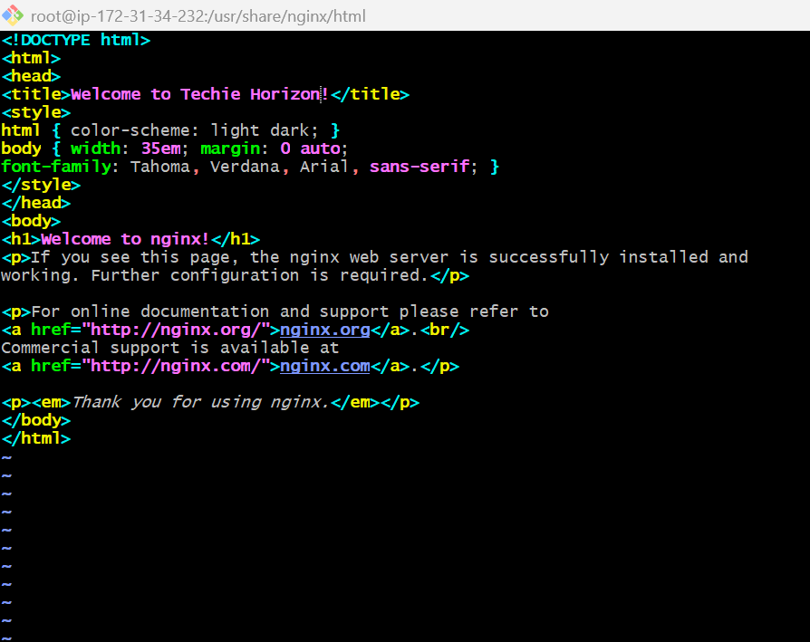
Tasks 3 & 4 – Nginx Web Server (Port 82)
Install Nginx, configure port 82, deploy index.html

Slide 9
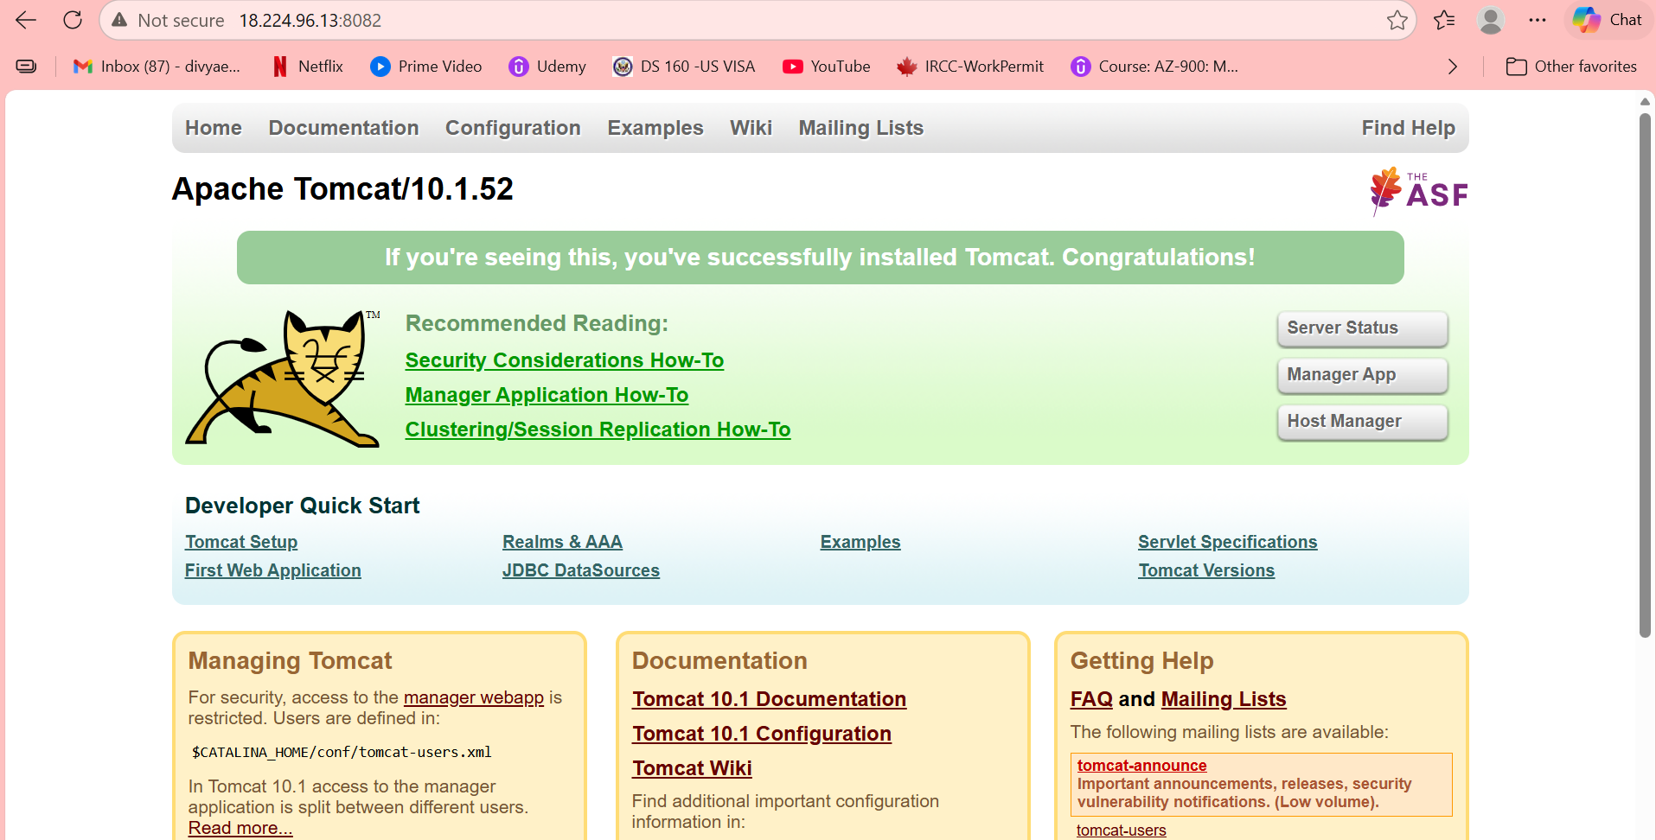
Task 5 – Apache Tomcat on Port 8082
Java application server for deploying .war apps
Install Tomcat 10
yum install tomcat10 -y installs Tomcat with all required dependencies including Java runtime. systemctl start/enable tomcat10 starts the service.
Change to Port 8082
Edit $CATALINA_HOME/conf/server.xml — change Connector port="8080" to port="8082". Open port 8082 in EC2 Security Group.
Tomcat 10 installed & active — systemctl status tomcat10

Slide 10
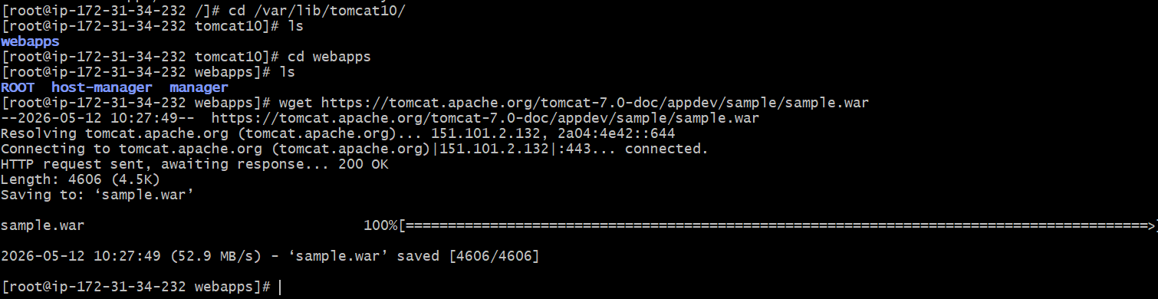
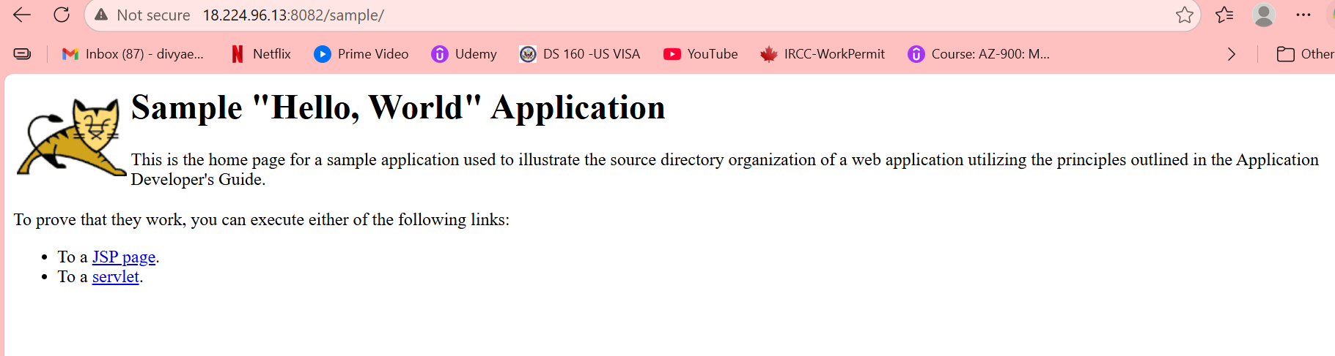
Task 6 – Deploy Sample App on Tomcat Webapps
Drop a .war file into webapps directory to deploy
Deploy to webapps/
Copy your sample .war or exploded app directory into $CATALINA_HOME/webapps/. Tomcat auto-deploys the application on restart.
Verify in Browser
Browse to http://<ip>:8082/ — the Apache Tomcat 10 welcome page confirms a successful installation and deployment.

Slide 11
Task 7 – Create tomcat.service for systemd
Register Tomcat as a managed Linux service
Service File Location
Key Directives
/etc/systemd/system/tomcat.service
Defines Unit, Service & Install sections for systemd.
ExecStart — path to catalina.sh
User/Group — tomcat service account
Restart=on-failure for auto recovery.
Enable & Start
Verify Status
systemctl daemon-reload reloads unit files.
systemctl enable tomcat makes it start at boot.
systemctl start tomcat launches the service.
systemctl status tomcat confirms Active: active (running).
Logs available via journalctl -u tomcat.

Slide 12
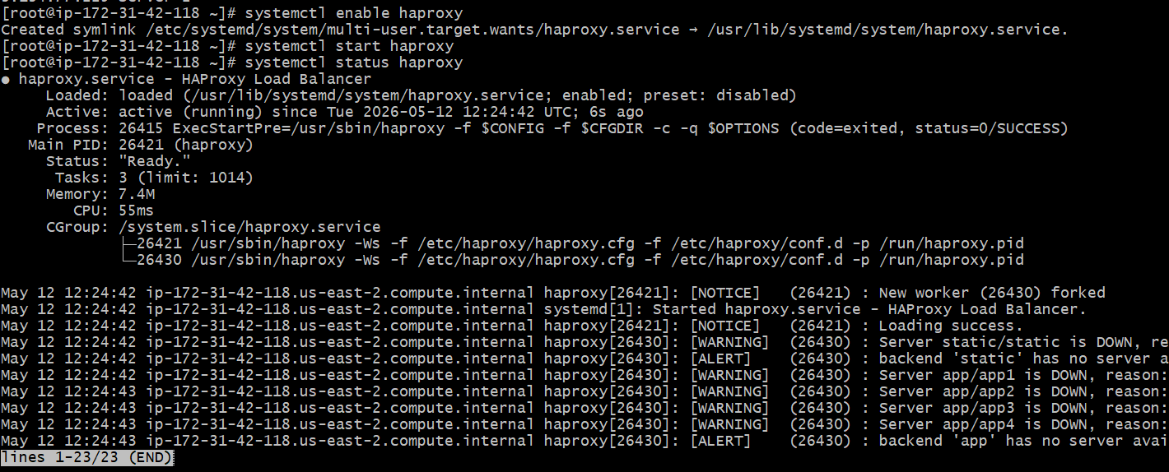
Task 8 – Configure HA Proxy Load Balancer
Distribute traffic across multiple backend servers
Install & Configure
yum install haproxy -y. Edit /etc/haproxy/haproxy.cfg — define frontend listening on port 80 and backend pointing to Server-1 and Server-2 private IPs.
Enable & Test
systemctl enable/start haproxy activates the service. Browse to HAProxy server's public IP:80 — it round-robins requests to Server-1 and Server-2.
HAProxy active — enabled & load-balancing confirmed

Slide 13
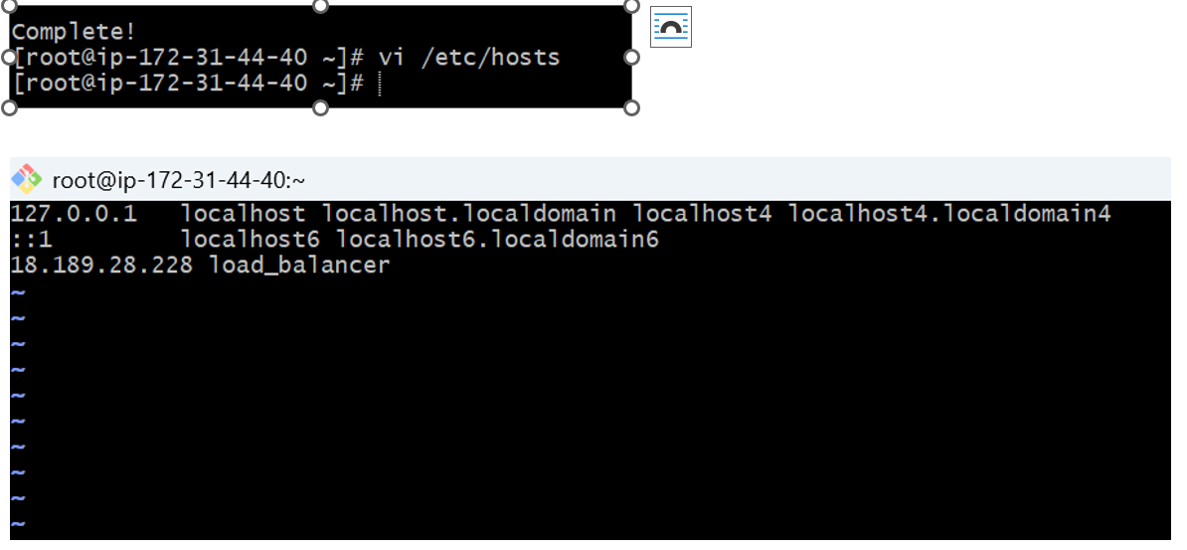
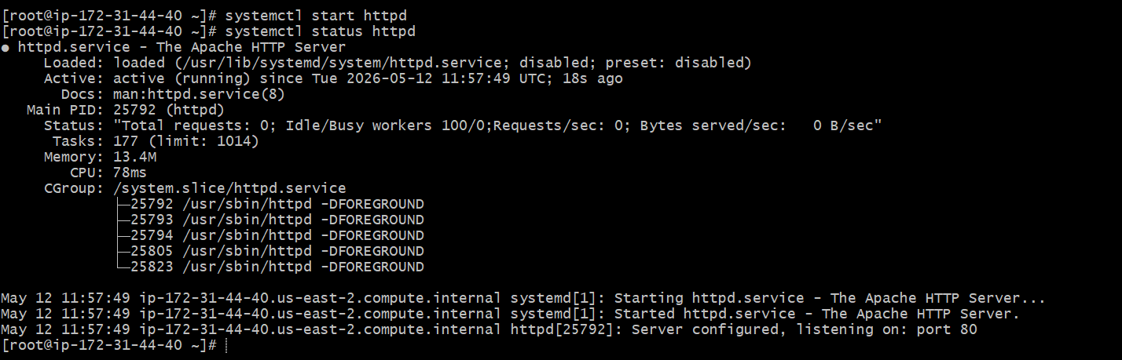

Task 8 – Configure HA Proxy Load Balancer
Server 1 --- HTTPD Service Configuration and add Loadbalancer IP to /etc/hosts

Slide 14
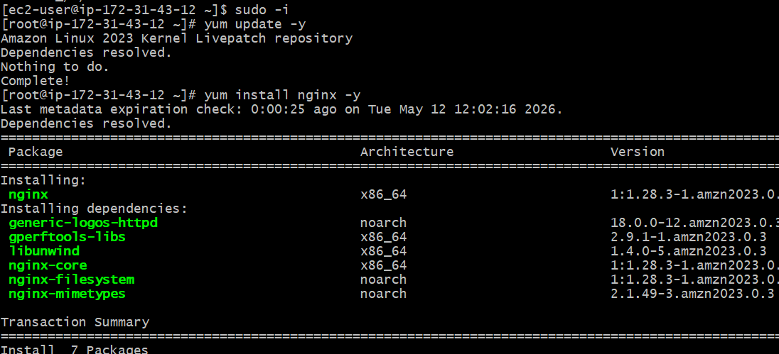
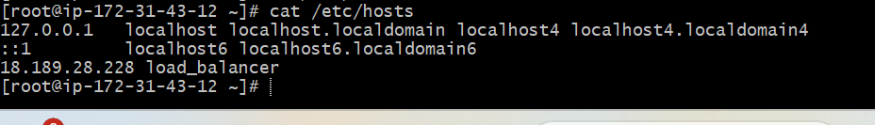
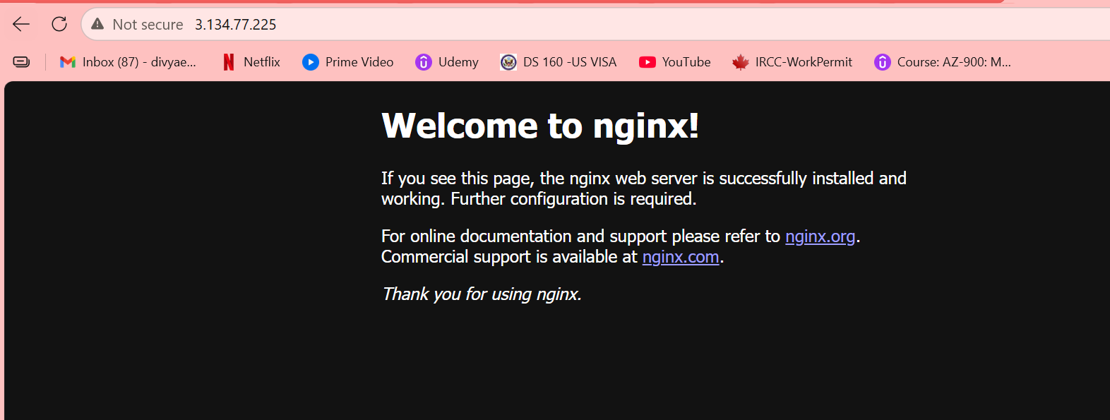
Task 8 – Configure HA Proxy Load Balancer
Server 2 --- Nginx Service Configuration and add Loadbalancer IP to /etc/hosts

Slide 15
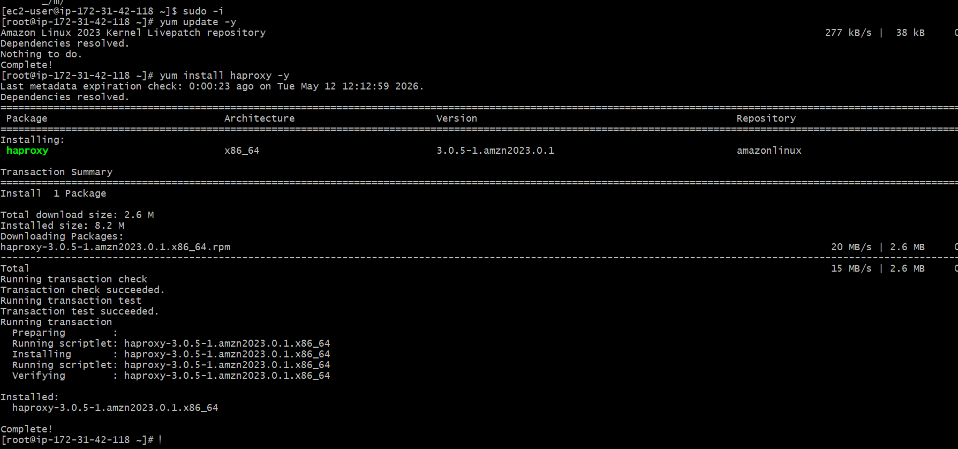
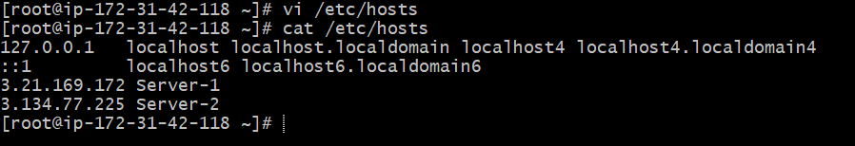
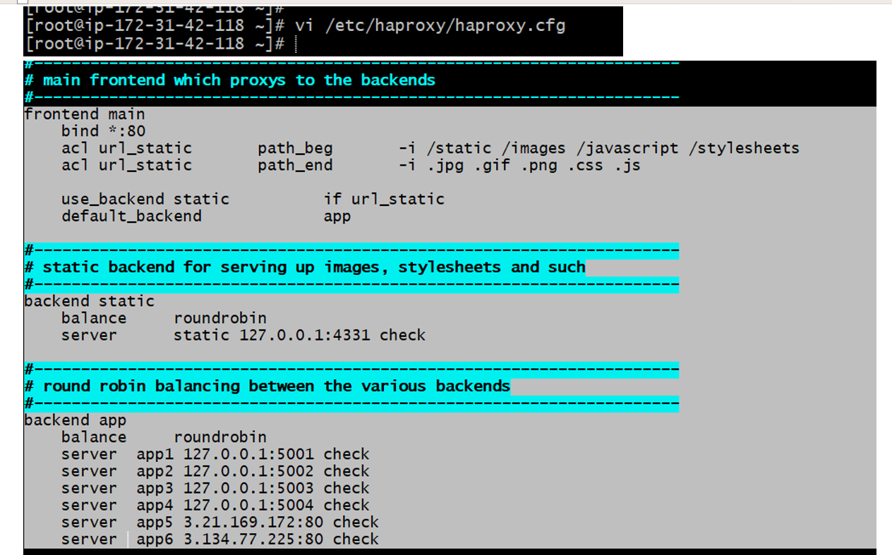
Task 8 – Configure HA Proxy Load Balancer
HA Proxy Server --- haproxy Service Configuration and add server1 and server2 IP to /etc/hosts

Slide 16
Architecture Overview
How the services fit together on AWS EC2
Apache
Port 81 | Web Server
Internet
HAProxy
Nginx
EC2
User Browser
Port 80 | Load Balancer
Port 82 | Web Server
AWS | Security Groups
Tomcat
Port 8082 | App Server

Slide 17
Key Takeaways
Apache & Nginx:
Both serve static content; port customization requires config file edits and firewall/SG rule updates.
Apache Tomcat:
Java-based app server; .war deployment via webapps/ directory; port changed in server.xml.
systemd Service:
Custom .service files enable auto-start, process supervision, and easy log access via journalctl.
HA Proxy:
Layer 4/7 load balancer; configured via haproxy.cfg; distributes HTTP traffic across backend servers.
All tasks performed on AWS EC2 — Amazon Linux 2023

Slide 18
THANK YOU

